Slide 1
Digital Control(I)- Lecture 6
Instructor: Sanghyuk Lee
Sanghyuk.Lee@xjtlu.edu.cn
Tel: 8816-1415
Department of Electrical and Electronic Engineering
XJTLU

Slide 2
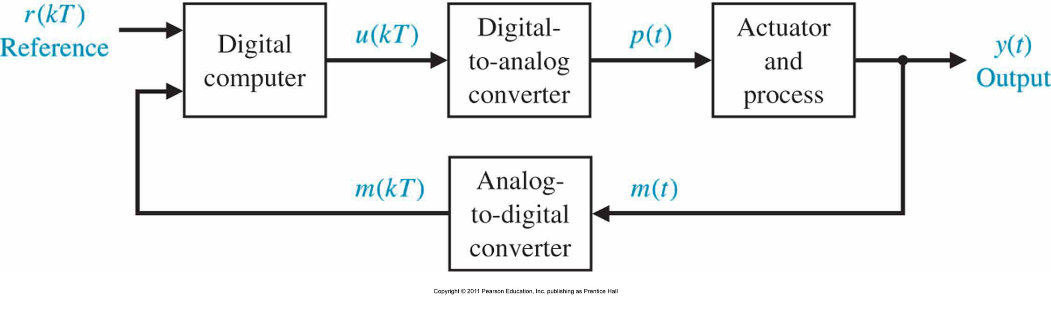
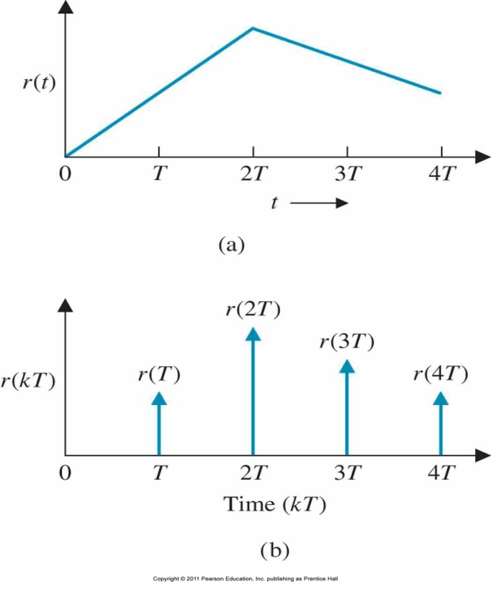
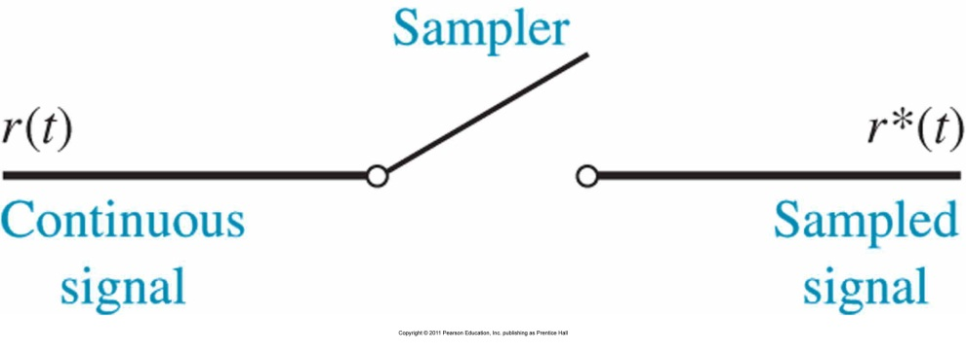

Sampled Data Systems
Sampled data (discrete signal) are data obtained for the sstem variables only at discrete intervals and are denoted as $x(kT)$

Slide 3
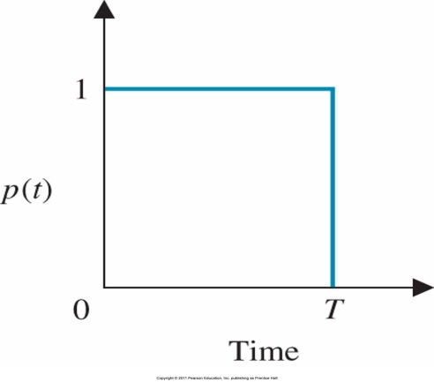
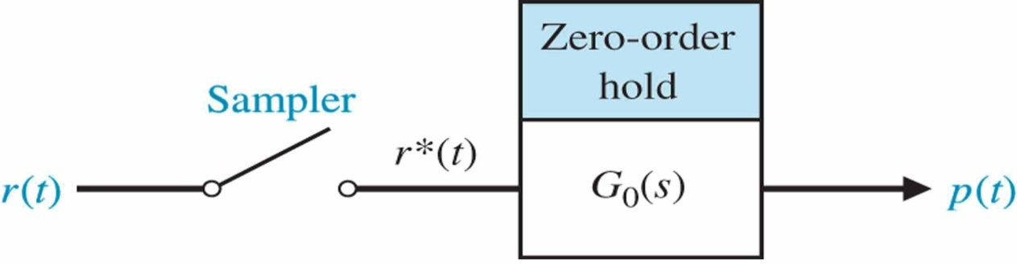
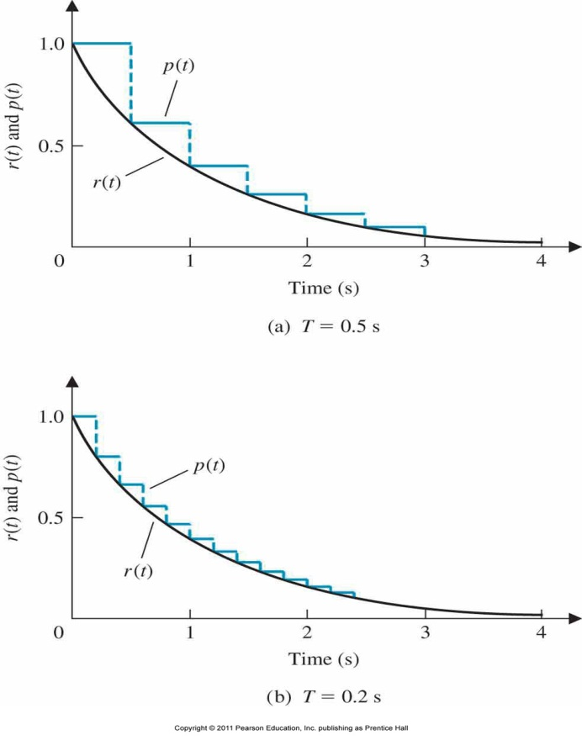
Sampled Data Systems
Zero order holder $G_{0}\left(s\right)=\frac{1−e^{−sT}}{s}$
The response of a zero-order hold to an impulse input r(kT), which equals unity when k = 0 and equals zero when k ≠ 0, so that r*(t) = r(0)δ(t).
The response of a sampler and zero-order hold to an input r (t) = e^{−t} for two values of sampling period T.

Slide 4
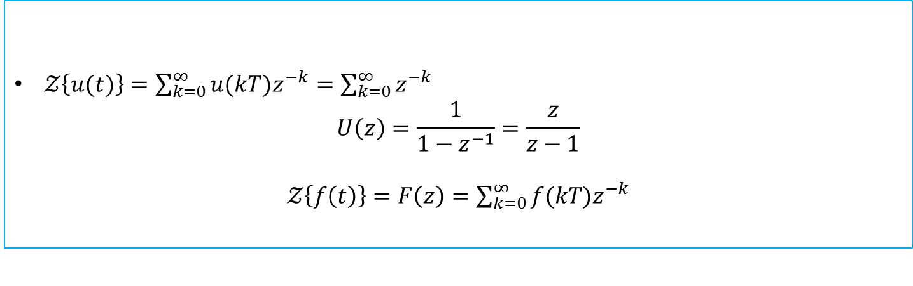
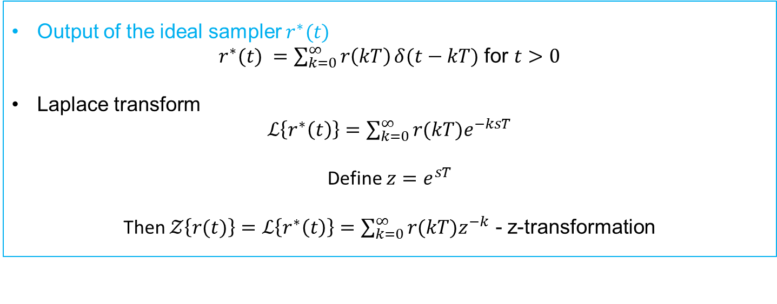
z-Transform
Output of the ideal sampler $r^{∗}(t)$
$r^{∗}(t) =\sum_{k=0}^{∞}{r\left(kT\right)}δ(t−kT)$ for $t>0$
Laplace transform
$ℒ\left\{r^{∗}\left(t\right)\right\}=\sum_{k=0}^{∞}{r(kT)e^{−ksT}}$
Define $z=e^{sT}$
Then $𝒵\left\{r(t)\right\}=ℒ\left\{r^{∗}\left(t\right)\right\}=\sum_{k=0}^{∞}{r(kT)z^{−k}}$ - z-transformation
Examples
$𝒵\left\{u(t)\right\}=\sum_{k=0}^{∞}{u(kT)z^{−k}}=\sum_{k=0}^{∞}{z^{−k}}$
$$U\left(z\right)=\frac{1}{1−z^{−1}}=\frac{z}{z−1}$$
$𝒵\left\{f\left(t\right)\right\}=F\left(z\right)=\sum_{k=0}^{∞}{f(kT)z^{−k}}$

Slide 5
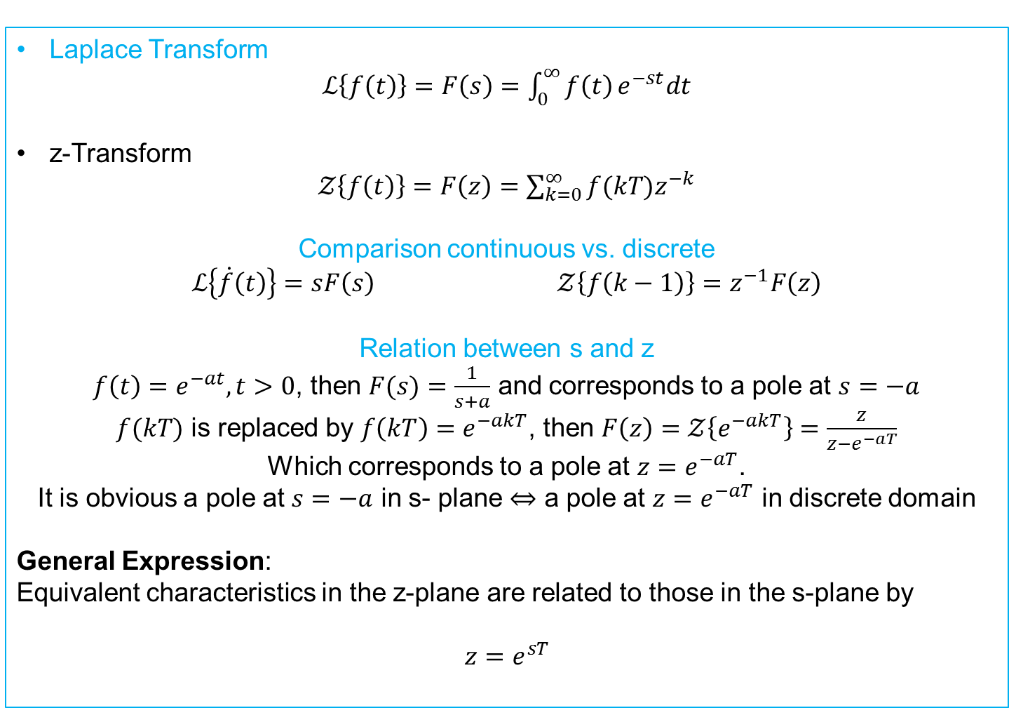
z-Transform
Laplace Transform
$ℒ\left\{f\left(t\right)\right\}=F\left(s\right)=\int_{0}^{∞}{f\left(t\right)}e^{−st}dt$
z-Transform
$𝒵\left\{f\left(t\right)\right\}=F\left(z\right)=\sum_{k=0}^{∞}{f(kT)z^{−k}}$
Comparison continuous vs. discrete
$ℒ\left\{\dot{f}\left(t\right)\right\}=sF\left(s\right)$ $𝒵\left\{f\left(k−1\right)\right\}=z^{−1}F\left(z\right)$
Relation between s and z
$f\left(t\right)=e^{−at}, t>0$, then $F(s)=\frac{1}{s+a}$ and corresponds to a pole at $s=−a$
$f(kT)$ is replaced by $f\left(kT\right)=e^{−akT}$, then $F\left(z\right)=𝒵\left\{e^{−akT}\right\}=\frac{z}{z−e^{−aT}}$
Which corresponds to a pole at $z=e^{−aT}$.
It is obvious a pole at $s=−a$ in s- plane $⇔$ a pole at $z=e^{−aT}$ in discrete domain
General Expression:
Equivalent characteristics in the z-plane are related to those in the s-plane by
$$z=e^{sT}$$

Slide 6
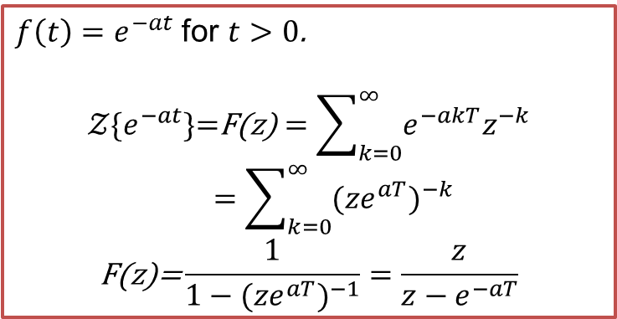
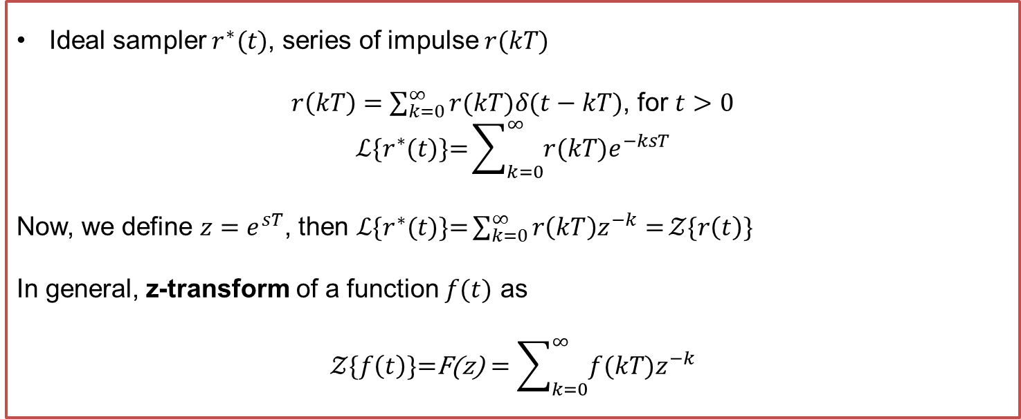
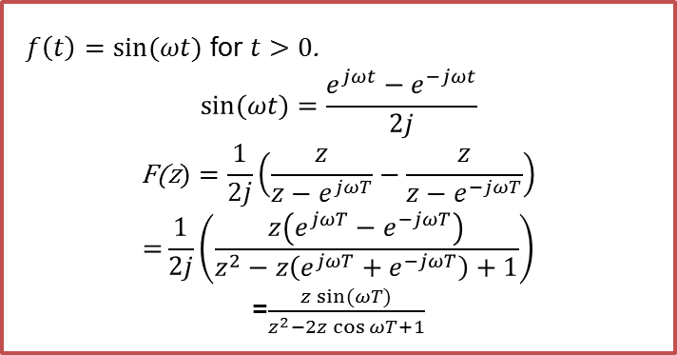
Z-transform
Ideal sampler $r^{∗}(t)$, series of impulse $r(kT)$
$r\left(kT\right)=\sum_{k=0}^{∞}{r(kT)δ(t−kT)}$, for $t>0$
$$ℒ\{r^{∗}(t)\text{\}=}\sum_{k=0}^{∞}{r(kT)e^{−ksT}}$$
Now, we define $z=e^{sT}$, then $ℒ\{r^{∗}(t)\text{\}=}\sum_{k=0}^{∞}{r\left(kT\right)z^{−k}=}𝒵\{r\left(t\right)\text{\}}$
In general, z-transform of a function $f(t)$ as
$$𝒵\{f\left(t\right)\text{\}=}\text{F}\text{(}\text{z}\text{)}=\sum_{k=0}^{∞}{f(kT)z^{−k}}$$
$f\left(t\right)=e^{−at}$ for $t>0$.
$$𝒵\{e^{−at}\text{\}=}\text{F}\text{(}\text{z}\text{)}=\sum_{k=0}^{∞}{e^{−akT}z^{−k}}=\sum_{k=0}^{∞}{{{(ze}^{aT})}^{−k}}$$
$$\text{F}\text{(}\text{z}\text{)=}\frac{1}{1−{{(ze}^{aT})}^{−1}}=\frac{z}{z−e^{−aT}}$$
$f\left(t\right)=\sin{(ωt)}$ for $t>0$.
$$\sin{(ωt)}=\frac{e^{jωt}−e^{−jωt}}{2j}$$
$$\text{F}\text{(}\text{z})=\frac{1}{2j}\left(\frac{z}{z−e^{jωT}}−\frac{z}{z−e^{−jωT}}\right)$$
$$\text{=}\frac{1}{2j}\left(\frac{z\left(e^{jωT}−e^{−jωT}\right)}{z^{2}−z\left(e^{jωT}+e^{−jωT}\right)+1}\right)$$
=$\frac{z\sin{(ωT)}}{z^{2}−2z\cos{ωT}+1}$

Slide 7
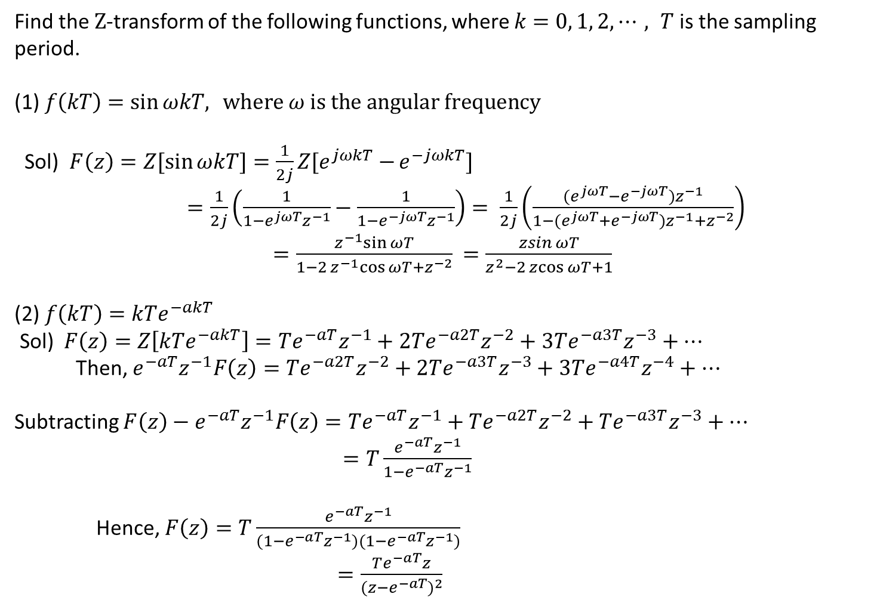
Examples
Find the $Z$-transform of the following functions, where $k=0, 1, 2, ⋯, T$ is the sampling period.
(1) $f\left(kT\right)=\sin{ωkT, } where ω is the angular frequency$
Sol) $F\left(z\right)=Z[\sin{ωkT]=\frac{1}{2j}Z[e^{jωkT}−}e^{−jωkT}]$
$=\frac{1}{2j}\left(\frac{1}{1−e^{jωT}z^{−1}}−\frac{1}{1−e^{−jωT}z^{−1}}\right)= \frac{1}{2j}\left(\frac{(e^{jωT}−e^{−jωT})z^{−1}}{1−{(e}^{jωT}+e^{−jωT})z^{−1}+z^{−2}}\right)$ $=\frac{z^{−1}sin{ωT}}{1−2z^{−1}cos{ωT}+z^{−2}}$ $=\frac{\operatorname{zsin}{ωT}}{z^{2}−2\operatorname{zcos}{ωT}+1}$
(2) $f\left(kT\right)=kTe^{−akT}$
Sol) $F\left(z\right)=Z\left[kTe^{−akT}\right]=Te^{−aT}z^{−1}+2Te^{−a2T}z^{−2}+3Te^{−a3T}z^{−3}+⋯$
Then, $e^{−aT}z^{−1}F\left(z\right)=Te^{−a2T}z^{−2}+2Te^{−a3T}z^{−3}+3Te^{−a4T}z^{−4}+⋯$
Subtracting $F\left(z\right)−e^{−aT}z^{−1}F\left(z\right)=Te^{−aT}z^{−1}+Te^{−a2T}z^{−2}+Te^{−a3T}z^{−3}+⋯$
$=T\frac{{e^{−aT}z}^{−1}}{1−{e^{−aT}z}^{−1}}$
Hence, $F\left(z\right)=T\frac{{e^{−aT}z}^{−1}}{(1−{e^{−aT}z}^{−1})(1−{e^{−aT}z}^{−1})}$
$=\frac{Te^{−aT}z}{{(z−e^{−aT})}^{2}}$

Slide 8
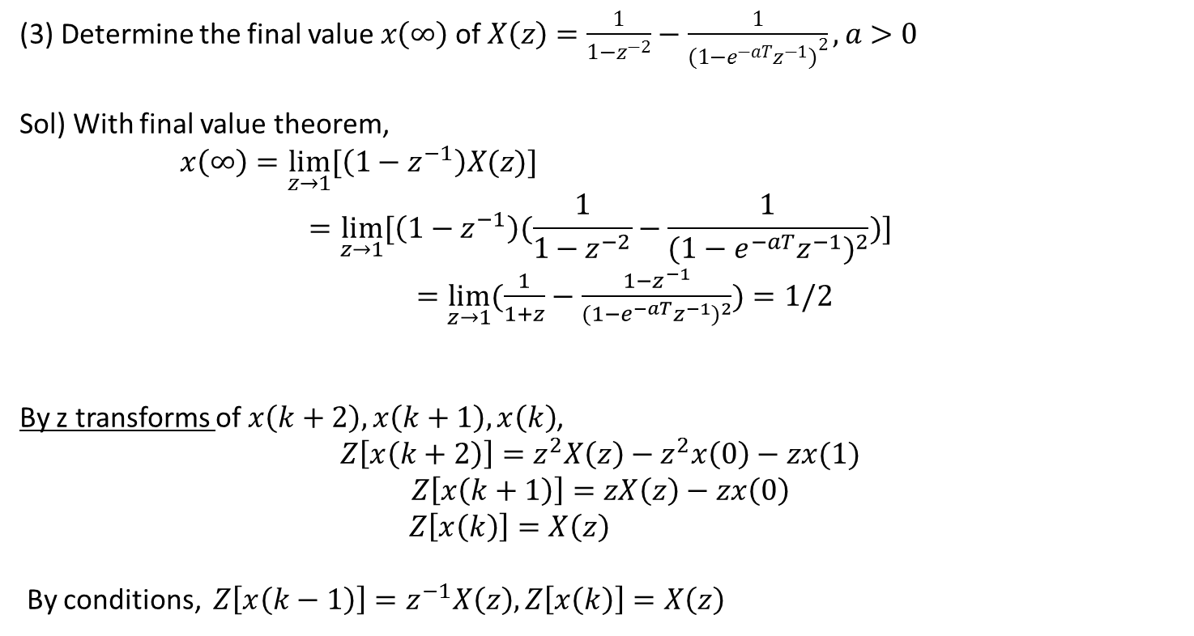
Examples
(3) Determine the final value $x\left(∞\right)$ of $X\left(z\right)=\frac{1}{1−z^{−2}}−\frac{1}{{(1−e^{−aT}z^{−1})}^{2}}, a>0$
Sol) With final value theorem,
$x\left(∞\right)=\lim_{z→1}{[\left(1−z^{−1}\right)X(z)]}$
$$=\lim_{z→1}{[\left(1−z^{−1}\right)(\frac{1}{1−z^{−2}}−\frac{1}{{(1−e^{−aT}z^{−1})}^{2}})]}$$
$=\lim_{z→1}{(\frac{1}{1+z}−\frac{1−z^{−1}}{{(1−e^{−aT}z^{−1})}^{2}})}=1/2$
By z transforms of $x\left(k+2\right), x\left(k+1\right), x\left(k\right)$,
$$Z\left[x\left(k+2\right)\right]=z^{2}X\left(z\right)−z^{2}x\left(0\right)−zx(1)$$
$$Z\left[x\left(k+1\right)\right]=zX\left(z\right)−zx\left(0\right)$$
$Z\left[x\left(k\right)\right]=X\left(z\right)$
By conditions, $Z\left[x\left(k−1\right)\right]=z^{−1}X\left(z\right),Z\left[x\left(k\right)\right]=X\left(z\right)$

Slide 9
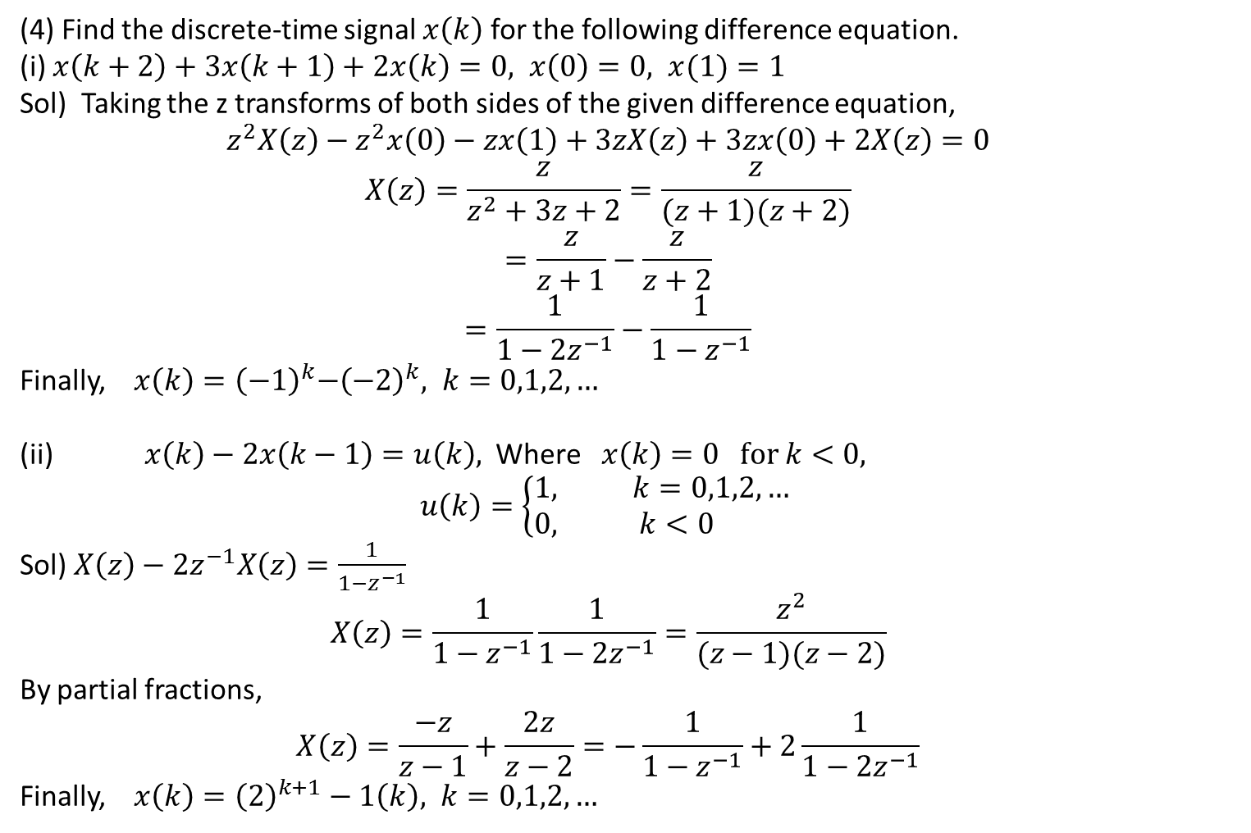
Examples
(4) Find the discrete-time signal $x\left(k\right)$ for the following difference equation.
(i) $x\left(k+2\right)+3x\left(k+1\right)+2x\left(k\right)=0, x\left(0\right)=0, x(1)=1$
Sol) Taking the z transforms of both sides of the given difference equation,
$$z^{2}X\left(z\right)−z^{2}x\left(0\right)−zx\left(1\right)+3zX\left(z\right)+3zx\left(0\right)+2X\left(z\right)=0$$
$$X\left(z\right)=\frac{z}{z^{2}+3z+2}=\frac{z}{(z+1)(z+2)}$$
$$=\frac{z}{z+1}−\frac{z}{z+2}$$
$$=\frac{1}{1−2z^{−1}}−\frac{1}{1−z^{−1}}$$
Finally, $x\left(k\right)={\left(−1\right)}^{k}{−\left(−2\right)}^{k}, k=0,1,2,…$
(ii) $x\left(k\right)−2x\left(k−1\right)=u\left(k\right),$ Where $x\left(k\right)=0 for k<0,$
$$u\left(k\right)=\left\{\begin{matrix}1, k=0,1,2,… \\ 0, k<0 \end{matrix}\right.$$
Sol) $X\left(z\right)−2z^{−1}X\left(z\right)=\frac{1}{1−z^{−1}}$
$$X\left(z\right)=\frac{1}{1−z^{−1}}\frac{1}{1−2z^{−1}}=\frac{z^{2}}{(z−1)(z−2)}$$
By partial fractions,
$$X\left(z\right)=\frac{−z}{z−1}+\frac{2z}{z−2}=−\frac{1}{1−z^{−1}}+2\frac{1}{1−{2z}^{−1}}$$
Finally, $x\left(k\right)={\left(2\right)}^{k+1}−1\left(k\right), k=0,1,2,…$

Slide 10

Examples
(5) Find the inverse $Z−$ transform of $X\left(z\right)=\frac{z+2}{(z−2)z^{2}}$ , $x\left(k\right)$ for $k≥0$.
Sol) Expanding $X\left(z\right)$ into partial fractions,
$$X\left(z\right)=\frac{z+2}{(z−2)z^{2}}=\frac{1}{z−2}−\frac{1}{z^{2}}−\frac{1}{z}$$
$X\left(z\right)=\frac{z^{−1}}{1−2z^{−1}}−z^{−2}−z^{−1}$
By inverse $Z−$transformation,
$$Z^{−1}\left[\frac{z^{−1}}{1−2z^{−1}}\right]=\left\{\begin{matrix}2^{k−1}, k=1,2,3,… \\ 0, k≤0 \end{matrix}\right.$$
$$Z^{−1}\left[z^{−2}\right]=\left\{\begin{matrix}1, k=2 \\ 0, k≠2 \end{matrix}\right.$$
$$Z^{−1}\left[z^{−1}\right]=\left\{\begin{matrix}1, k=1 \\ 0, k≠1 \end{matrix}\right.$$
Hence,
$x\left(k\right)=\left\{\begin{matrix}0, k=0,1 \\ 1, k=2 \\ 2^{k−1}, k=3,4,5,…\end{matrix}\right.$

Slide 11
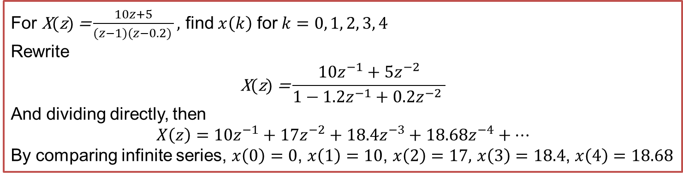
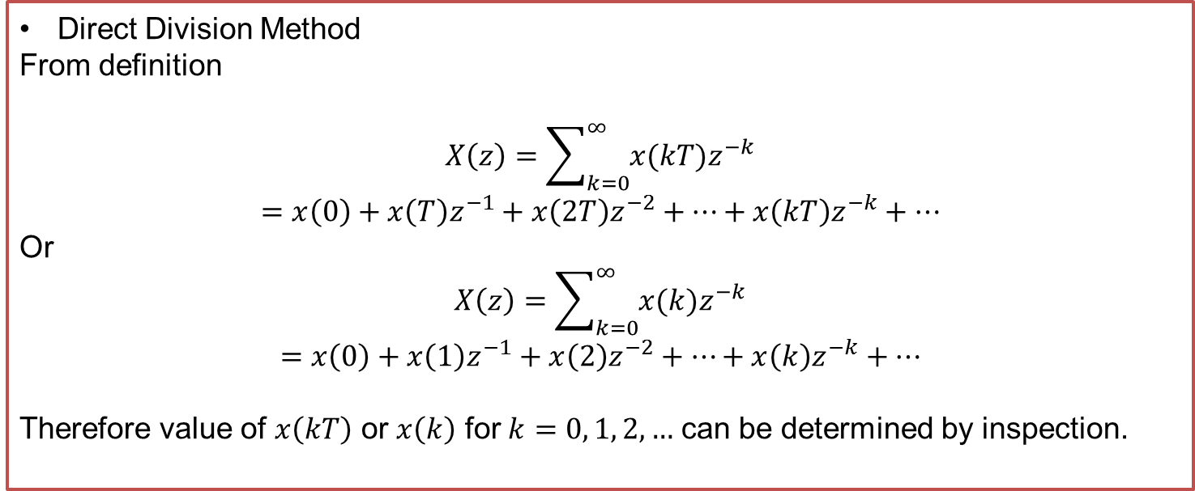
Inverse Z-transform
Direct Division Method
From definition
$$X\left(z\right)=\sum_{k=0}^{∞}{x(kT)z^{−k}}$$
$$=x\left(0\right)+x\left(T\right)z^{−1}+x\left(2T\right)z^{−2}+…+x\left(kT\right)z^{−k}+…$$
Or
$$X\left(z\right)=\sum_{k=0}^{∞}{x(k)z^{−k}}$$
$$=x\left(0\right)+x\left(1\right)z^{−1}+x\left(2\right)z^{−2}+…+x\left(k\right)z^{−k}+…$$
Therefore value of $x\left(kT\right)$ or $x\left(k\right)$ for $k=0, 1, 2, …$ can be determined by inspection.
For $\text{X}\text{(}\text{z}\text{)} \text{=}\frac{10z+5}{(z−1)(z−0.2) },$ find $x\left(k\right)$ for $k=0, 1, 2, 3, 4$
Rewrite
$$\text{X}\text{(}\text{z}\text{)}\text{ =}\frac{10z^{−1}+5z^{−2}}{1−1.2z^{−1}+0.2z^{−2} }$$
And dividing directly, then
$$X\left(z\right)=10z^{−1}+17z^{−2}+18.4z^{−3}+18.68z^{−4}+…$$
By comparing infinite series, $x\left(0\right)=0$, $x\left(1\right)=10$, $x\left(2\right)=17,$ $x\left(3\right)=18.4$, $x\left(4\right)=18.68$

Slide 12
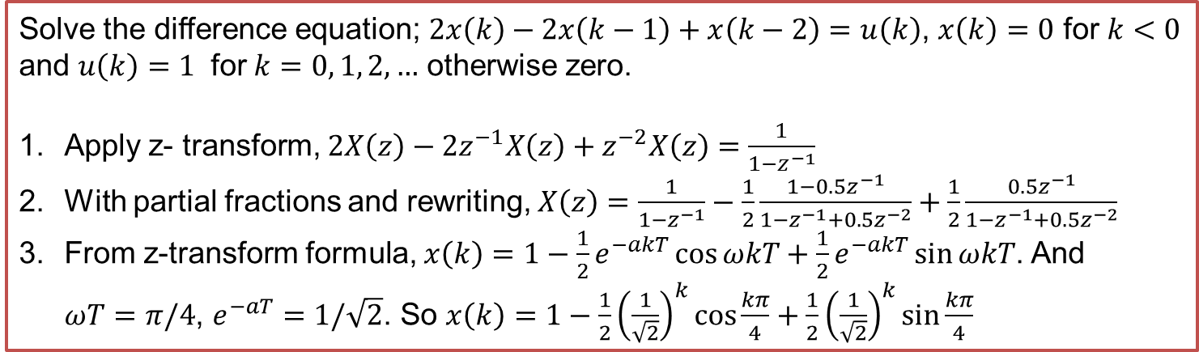
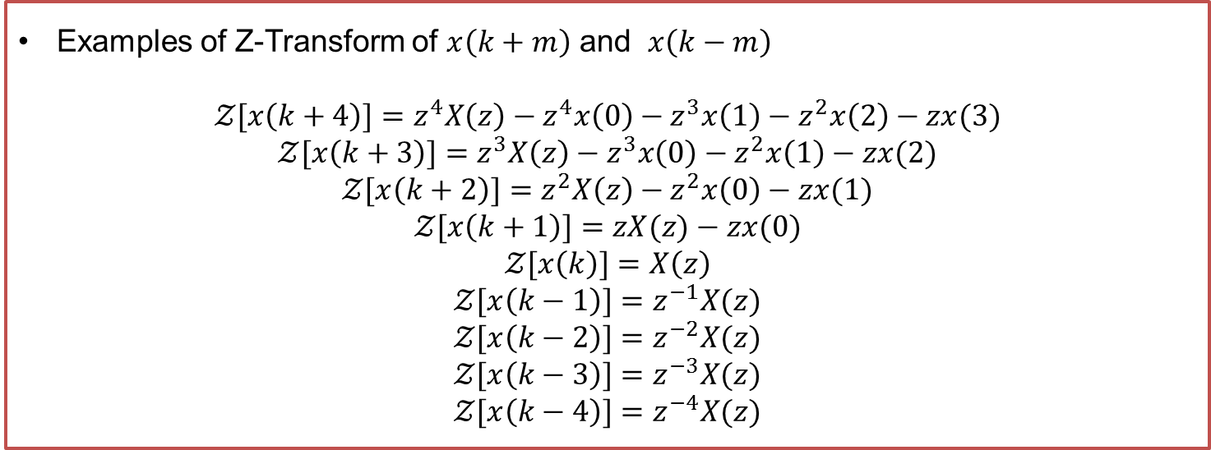
Difference Equation
Examples of Z-Transform of $x\left(k+m\right)$ and $x\left(k−m\right)$
$$𝒵[x\left(k+4\right)]=z^{4}X\left(z\right)−z^{4}x\left(0\right)−z^{3}x\left(1\right)−z^{2}x\left(2\right)−zx(3)$$
$$𝒵[x\left(k+3\right)]=z^{3}X\left(z\right)−z^{3}x\left(0\right)−z^{2}x\left(1\right)−zx(2)$$
$$𝒵[x\left(k+2\right)]=z^{2}X\left(z\right)−z^{2}x\left(0\right)−zx(1)$$
$$𝒵[x\left(k+1\right)]=zX(z)−zx(0)$$
$$𝒵[x\left(k\right)]=X\left(z\right)$$
$$𝒵[x\left(k−1\right)]=z^{−1}X(z)$$
$$𝒵[x\left(k−2\right)]=z^{−2}X(z)$$
$$𝒵[x\left(k−3\right)]=z^{−3}X(z)$$
$$𝒵[x\left(k−4\right)]=z^{−4}X(z)$$
Solve the difference equation; $2x\left(k\right)−2x\left(k−1\right)+x\left(k−2\right)=u\left(k\right)$, $x\left(k\right)=0$ for $k<0$ and $u\left(k\right)=1$ for $k=0, 1, 2, …$ otherwise zero.
Apply z- transform, $2X\left(z\right)−2z^{−1}X\left(z\right)+z^{−2}X\left(z\right)=\frac{1}{1−z^{−1}}$
With partial fractions and rewriting, $X\left(z\right)=\frac{1}{1−z^{−1}}−\frac{1}{2}\frac{1−{0.5z}^{−1}}{1−z^{−1}+0.5z^{−2}}+\frac{1}{2}\frac{{0.5z}^{−1}}{1−z^{−1}+0.5z^{−2}}$
From z-transform formula, $x\left(k\right)=1−\frac{1}{2}e^{−akT}\cos{ωkT}+\frac{1}{2}e^{−akT}\sin{ωkT}$. And $ωT=π/4$, $e^{−aT}=1/\sqrt{2}$. So $x\left(k\right)=1−\frac{1}{2}{\left(\frac{1}{\sqrt{2}}\right)}^{k}\cos{\frac{kπ}{4}}+\frac{1}{2}{\left(\frac{1}{\sqrt{2}}\right)}^{k}\sin{\frac{kπ}{4}}$

Slide 13
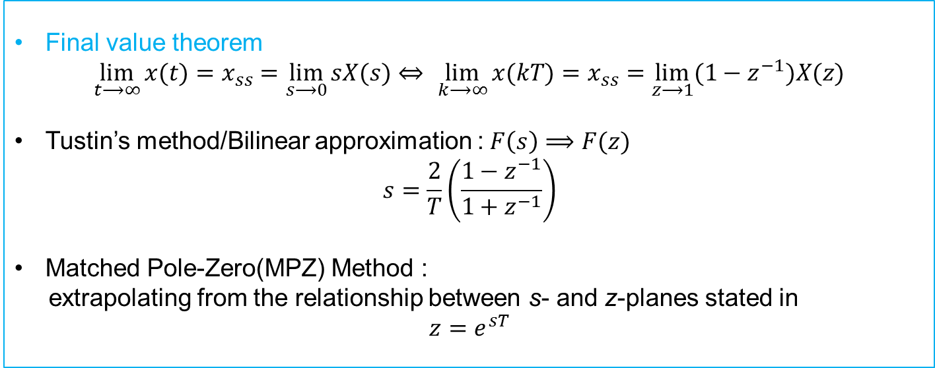
Characteristic comparison/Digitization
Final value theorem
$\lim_{t⟶∞}{x(t)}=x_{ss}=\lim_{s⟶0}{sX(s)}$ $⇔$ $\lim_{k⟶∞}{x(kT)}=x_{ss}=\lim_{z⟶1}{(1−z^{−1})X(z)}$
Tustin’s method/Bilinear approximation : $F\left(s\right)⟹F(z)$
$$s=\frac{2}{T}\left(\frac{1−z^{−1}}{1+z^{−1}}\right)$$
Matched Pole-Zero(MPZ) Method :
extrapolating from the relationship between s- and z-planes stated in
$$z=e^{sT}$$

Slide 14
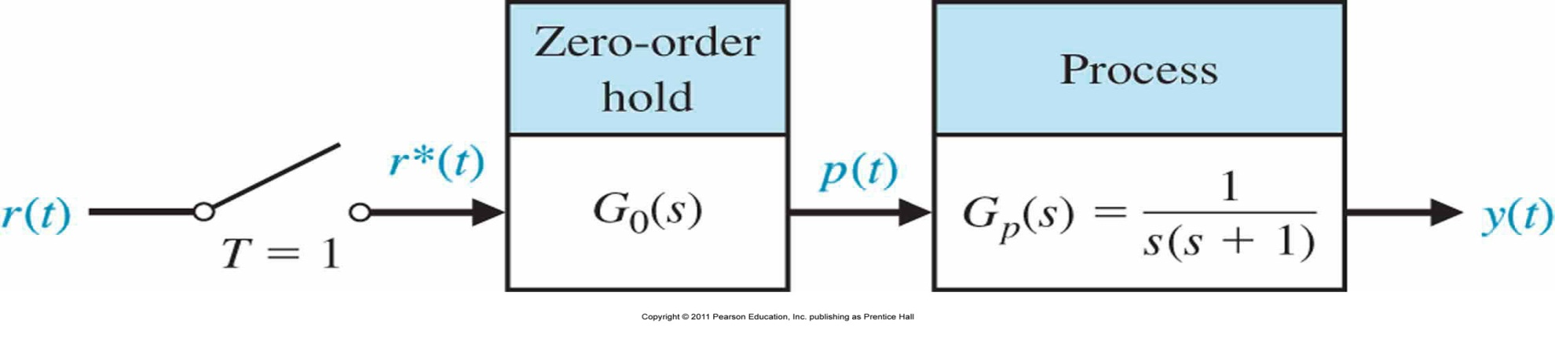
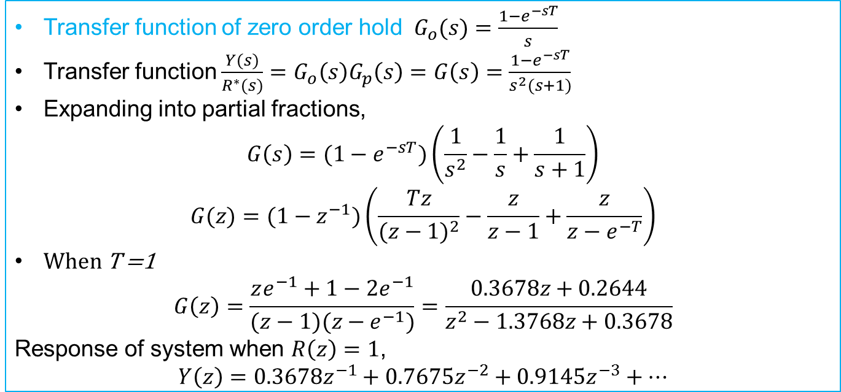
Transfer Function/open loop system
Transfer function of zero order hold $G_{o}(s)=\frac{1−e^{−sT}}{s}$
Transfer function $\frac{Y(s)}{R^{∗}(s)}=G_{o}\left(s\right)G_{p}\left(s\right)=G\left(s\right)=\frac{1−e^{−sT}}{s^{2}(s+1)}$
Expanding into partial fractions,
$$G\left(s\right)=(1−e^{−sT})\left(\frac{1}{s^{2}}−\frac{1}{s}+\frac{1}{s+1}\right)$$
$$G(z)=(1−z^{−1})\left(\frac{Tz}{{(z−1)}^{2}}−\frac{z}{z−1}+\frac{z}{z−e^{−T}}\right)$$
When T =1
$$G\left(z\right)=\frac{ze^{−1}+1−2e^{−1}}{(z−1)(z−e^{−1})}=\frac{0.3678z+0.2644}{z^{2}−1.3768z+0.3678}$$
Response of system when $R\left(z\right)=1$,
$$Y\left(z\right)=0.3678z^{−1}+0.7675z^{−2}+0.9145z^{−3}+…$$

Slide 15
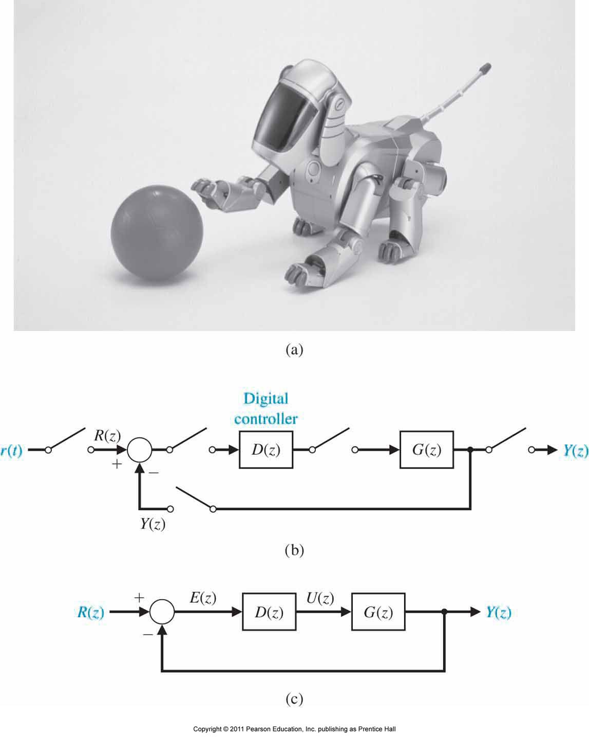

Closed loop Feedback Sampled-Data System
Closed loop transfer function
$$\frac{Y(z)}{R(z)}=T\left(z\right)=\frac{G\left(z\right)D(z)}{1+G\left(z\right)D(z)}$$

Slide 16
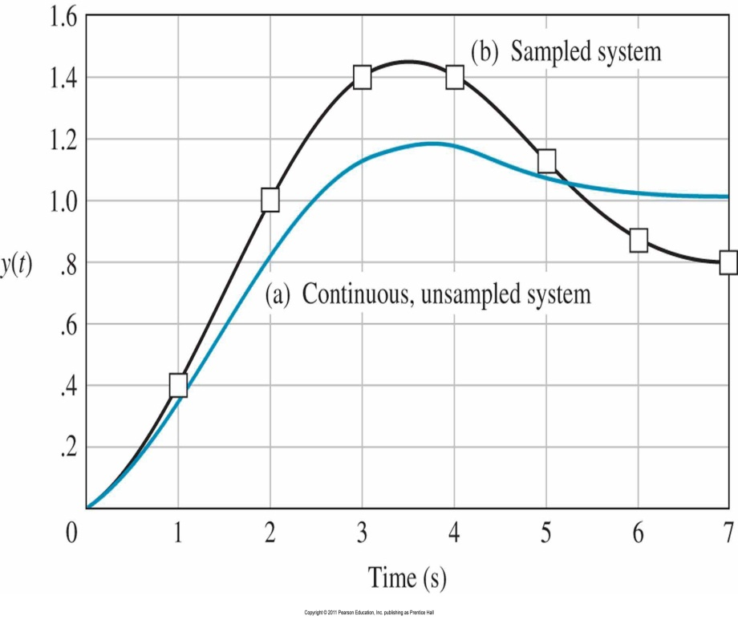
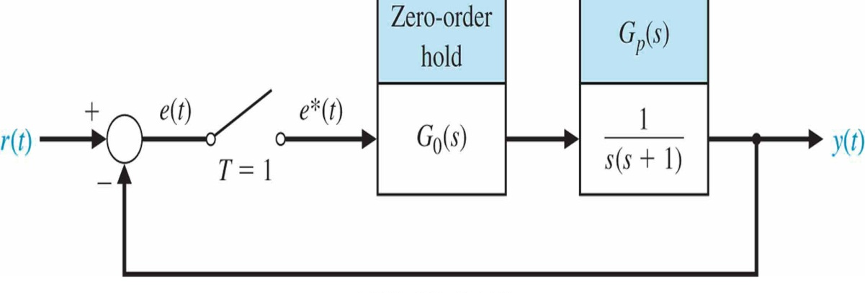
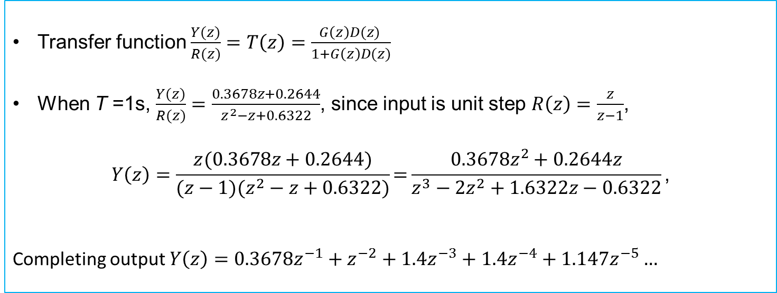
Transfer Function/closed loop system
Transfer function $\frac{Y(z)}{R(z)}=T\left(z\right)=\frac{G\left(z\right)D(z) }{1+G\left(z\right)D(z)}$
When T =1s, $\frac{Y(z)}{R(z)}=\frac{0.3678z+0.2644}{z^{2}−z+0.6322}$, since input is unit step $R\left(z\right)=\frac{z}{z−1}$,
$$Y\left(z\right)=\frac{z(0.3678z+0.2644)}{(z−1)(z^{2}−z+0.6322)}\text{=}\frac{0.3678z^{2}+0.2644z}{z^{3}−2z^{2}+1.6322z−0.6322}\text{,}$$
Completing output $Y\left(z\right)=0.3678z^{−1}+z^{−2}+1.4z^{−3}+1.4z^{−4}+1.147z^{−5}…$

Slide 17
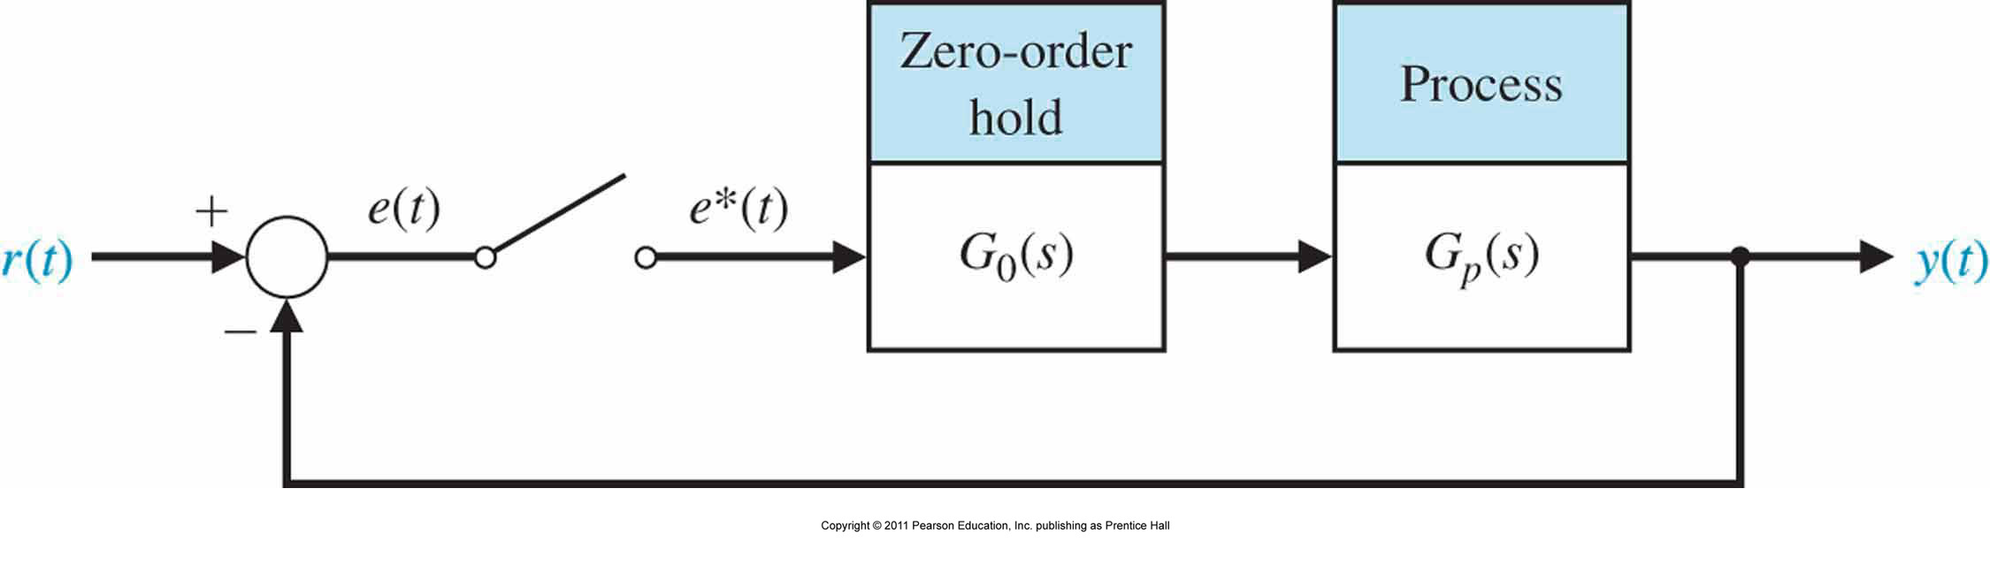
Stability of the closed loop system
For $G_{p}\left(s\right)=\frac{K }{s(s+1)}$ and sample time T = 1
When T =1s, $\frac{Y(z)}{R(z)}=\frac{0.3678z+0.2644}{z^{2}−z+0.6322}$, since input is unit step $R\left(z\right)=\frac{z}{z−1}$,
$$Y\left(z\right)=\frac{z(0.3678z+0.2644)}{(z−1)(z^{2}−z+0.6322)}\text{=}\frac{0.3678z^{2}+0.2644z}{z^{3}−2z^{2}+1.6322z−0.6322}\text{,}$$
Completing output $Y\left(z\right)=0.3678z^{−1}+z^{−2}+1.4z^{−3}+1.4z^{−4}+1.147z^{−5}…$

Slide 18
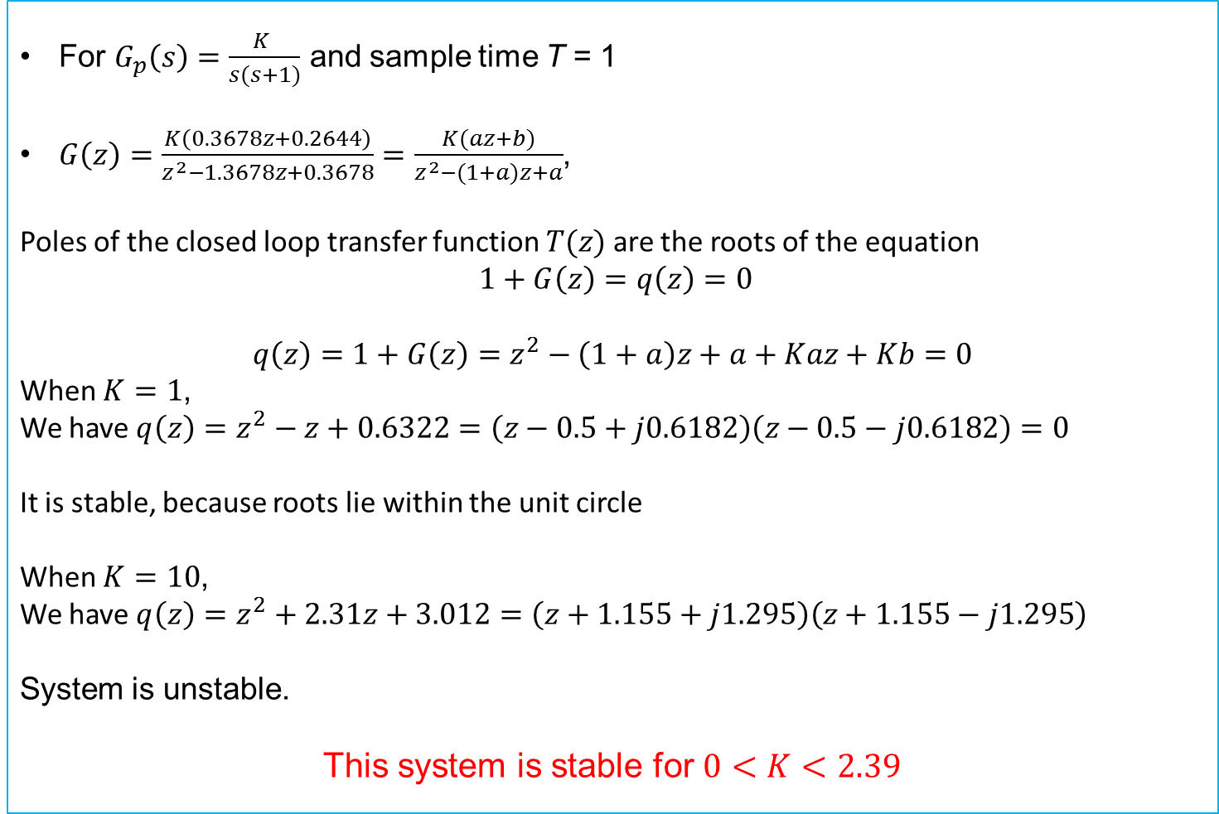
Stability of the closed loop system- Example
For $G_{p}\left(s\right)=\frac{K }{s(s+1)}$ and sample time T = 1
$G\left(z\right)=\frac{K\left(0.3678z+0.2644\right)}{z^{2}−1.3678z+0.3678}=\frac{K(az+b)}{z^{2}−(1+a)z+a}$,
Poles of the closed loop transfer function $T(z)$ are the roots of the equation
$1+G\left(z\right)=q\left(z\right)=0$
$$q\left(z\right)=1+G\left(z\right)=z^{2}−\left(1+a\right)z+a+Kaz+Kb=0$$
When $K=1$,
We have $q\left(z\right)=z^{2}−z+0.6322=\left(z−0.5+j0.6182\right)\left(z−0.5−j0.6182\right)=0$
It is stable, because roots lie within the unit circle
When $K=10$,
We have $q\left(z\right)=z^{2}+2.31z+3.012=\left(z+1.155+j1.295\right)\left(z+1.155−j1.295\right)$
System is unstable.
This system is stable for $0<K<2.39$

Slide 19
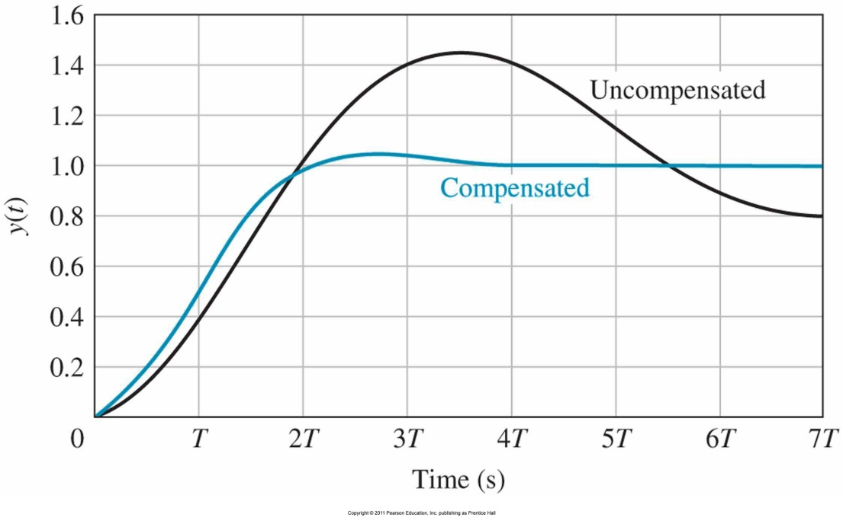
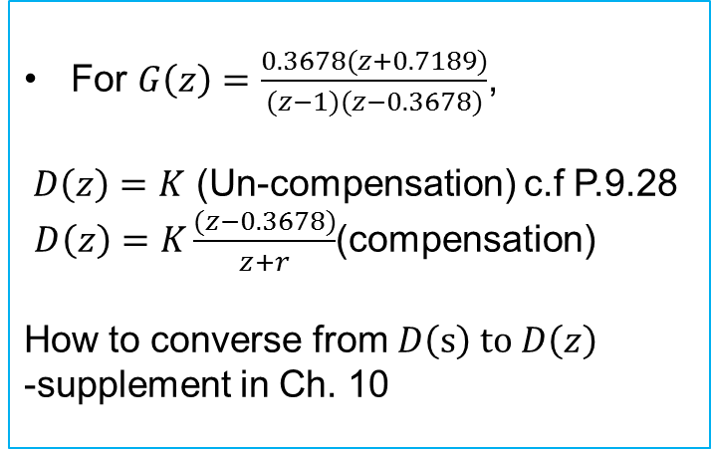

Closed Loop system - Digital Compensation
Consider closed loop system
$$\frac{Y(z)}{R(z)}=T\left(z\right)=\frac{G\left(z\right)D(z)}{1+G(z)D(z)}$$
For $G\left(z\right)=\frac{0.3678(z+0.7189)}{(z−1)(z−0.3678)}$,
$D\left(z\right)=K$ (Un-compensation) c.f P.9.28
$D\left(z\right)=K\frac{(z−0.3678)}{z+r}$(compensation)
How to converse from $D\left(s\right) to D\left(z\right)$
-supplement in Ch. 10

Slide 20
End of Lecture
Digital Control- Lecture 6
Instructor: Sanghyuk Lee
Sanghyuk.Lee@xjtlu.edu.cn
Tel: 8816-1415
Department of Electrical and Electronic Engineering
XJTLU

